Slide 1
Computational ecology approaches to understanding cyanobacteria: It's just ecology but with more computers!
Jeff Hollister, Stephen Shivers, Sophie Fournier, and Betty Kreakie

Slide 2
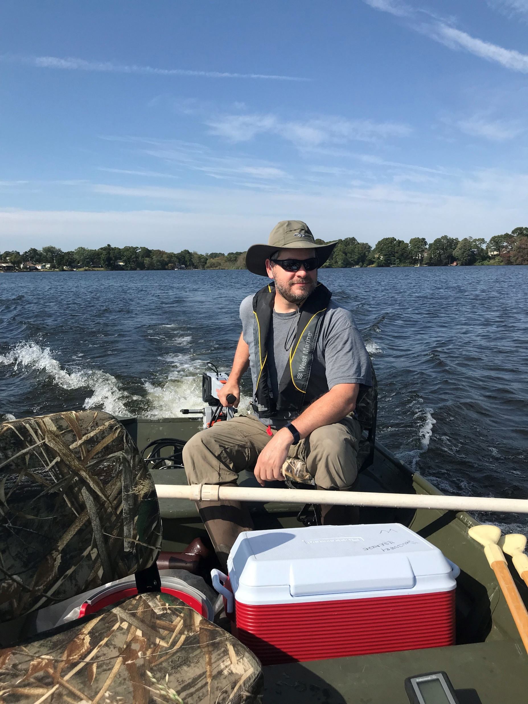
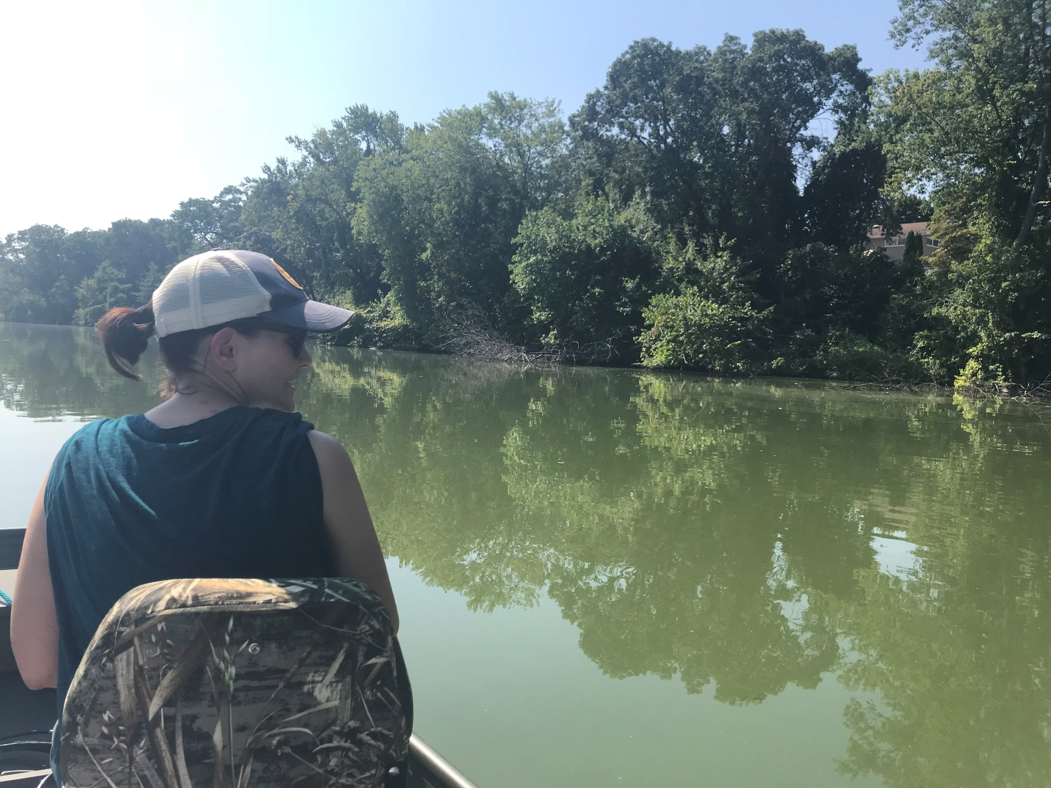
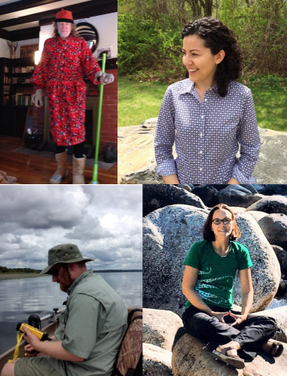
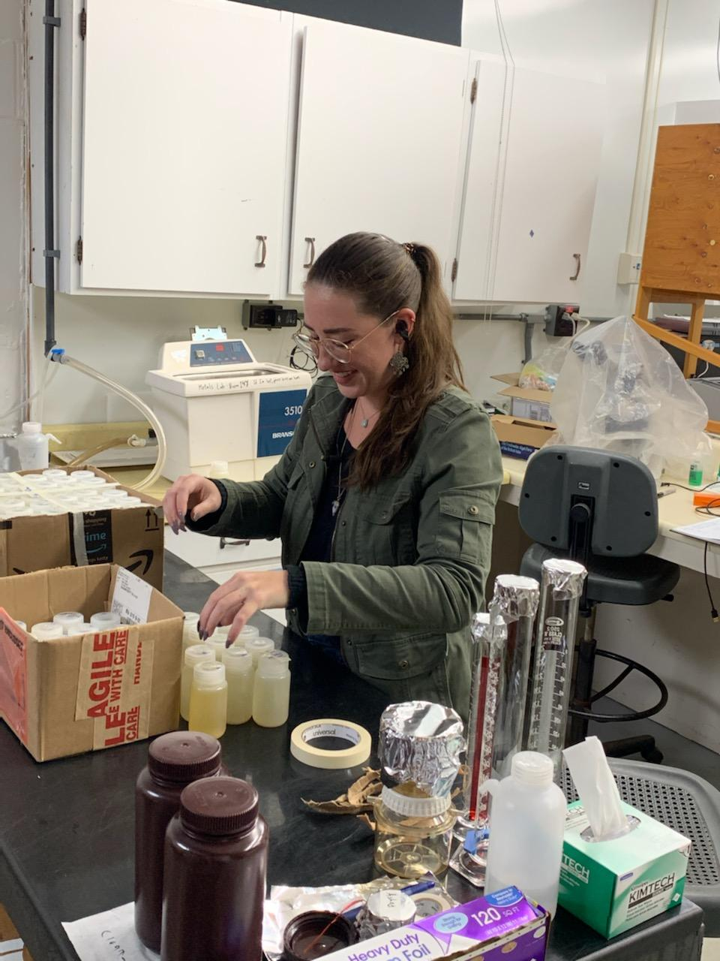
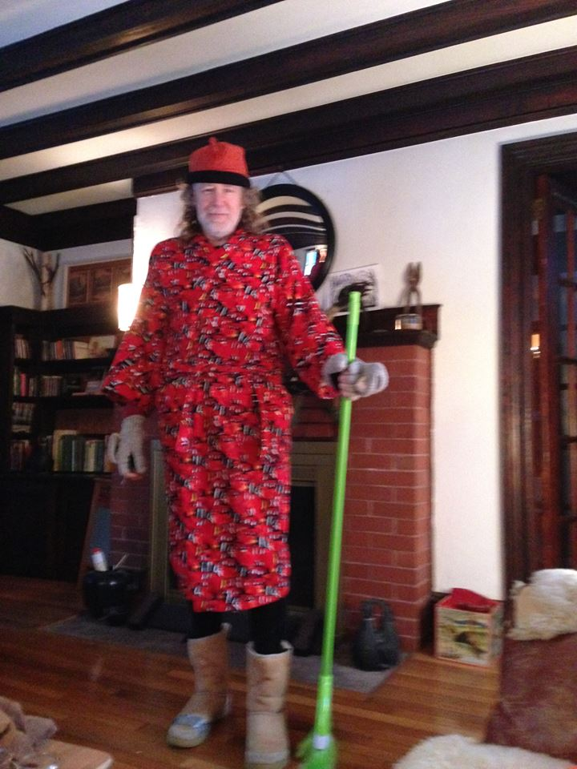
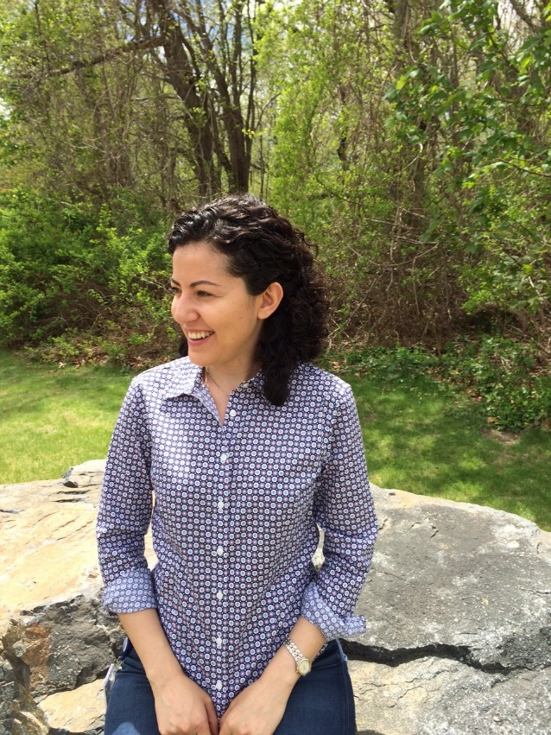
Computational Ecology Team
Alumni
Jeff Hollister
Betty Kreakie
Stephen Shivers
Sophie Fournier
Bryan Milstead
Farnaz Nojavan

Slide 3
Partners and collaborators
ACESD Comp Ecology
Me
Betty Kreakie
Stephen Shivers
Sophie Fournier
Anne Kuhn
Alums: Farnaz Nojavan, Bryan Milstead
ACESD
Jonathan Serbst
Steve Rego
Barbara Sherman
Joe LiVolsi
Dave Katz
Don Cobb
Adam Pimenta
Nate Merrill
Rick McKinney
Autumn Oczkowski
Peg Pelletier
John Kiddon
Mike Charpentier
EPA Region 1
Hilary Snook
Katrina Kipp
EPA Region 7
Steve Krabbe
Chris Taylor
Laura Webb
Steve Baker
Gary Welker
Elsewhere in ORD
Ann Vega
Jake Beaulieu
Blake Schaeffer
Jay Christensen
Betsy Hilborn
Elsewhere in EPA
Shelly Thawley
David Smith
USGS
Keith Loftin
Jennifer Graham
NOAA
Jerry Prezioso
URI
Elizabeth Herron
Linda Green
Art Gold
Q Kellogg
RIDEM
Bryan Zalewsky
Jane Sawyers
Sue Kiernan
Elsewhere in Rhode Island
Friends of Warwick Pond
Mashapaug Folks

Slide 4
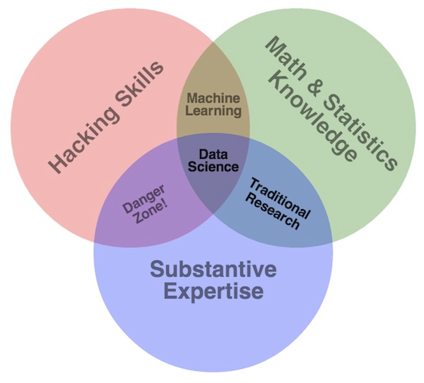
What is computational ecology?
Subset of data science
Interdisciplinary
Combines:
Programming
Mathematical/statistical methods
ecological subject-specific expertise
Drew Conway’s Data Science Venn Diagram: http://drewconway.com/zia/2013/3/26/the-data-science-venn-diagram

Slide 5



What does the computational ecology group do?
Advocate
Computational/Data Intensive Research
Agency data science initiatives
Build expertise
Support other research efforts
Apply to our own research
Current focus: Freshwater ecology and HABs

Slide 6
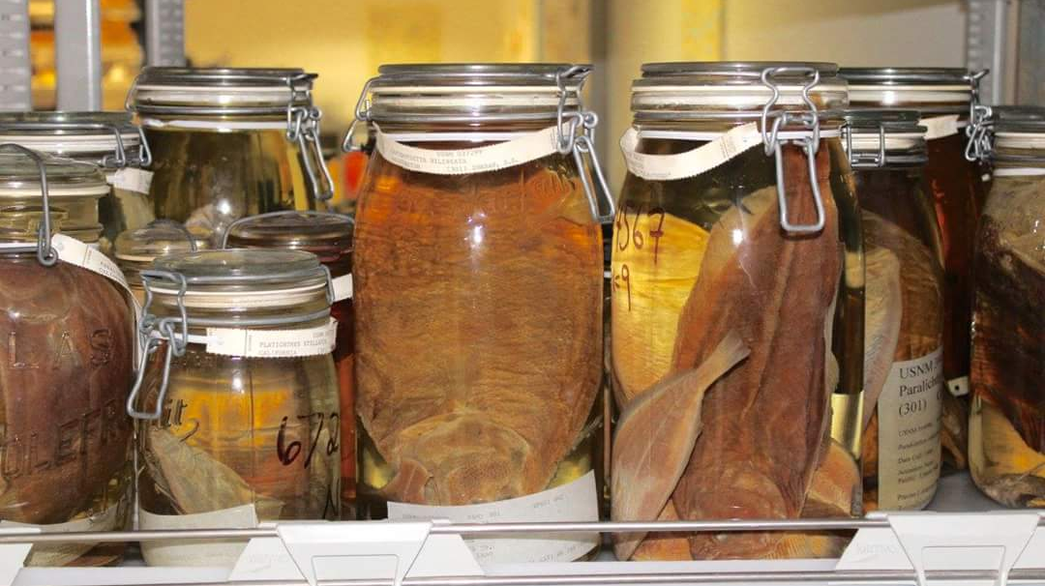
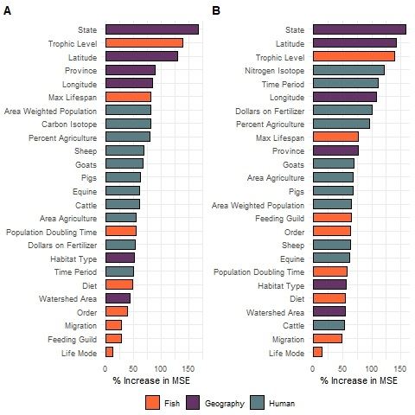
Computational ecology examples: Stable isotopes
Oczkowski, et al. 2020. Geography, not human impact, is the predominant predictor in a 150-year stable isotope fish record from the coastal United States. Ecological Indicators
Old school data
Random Forests
Nitrogen
Carbon

Slide 7
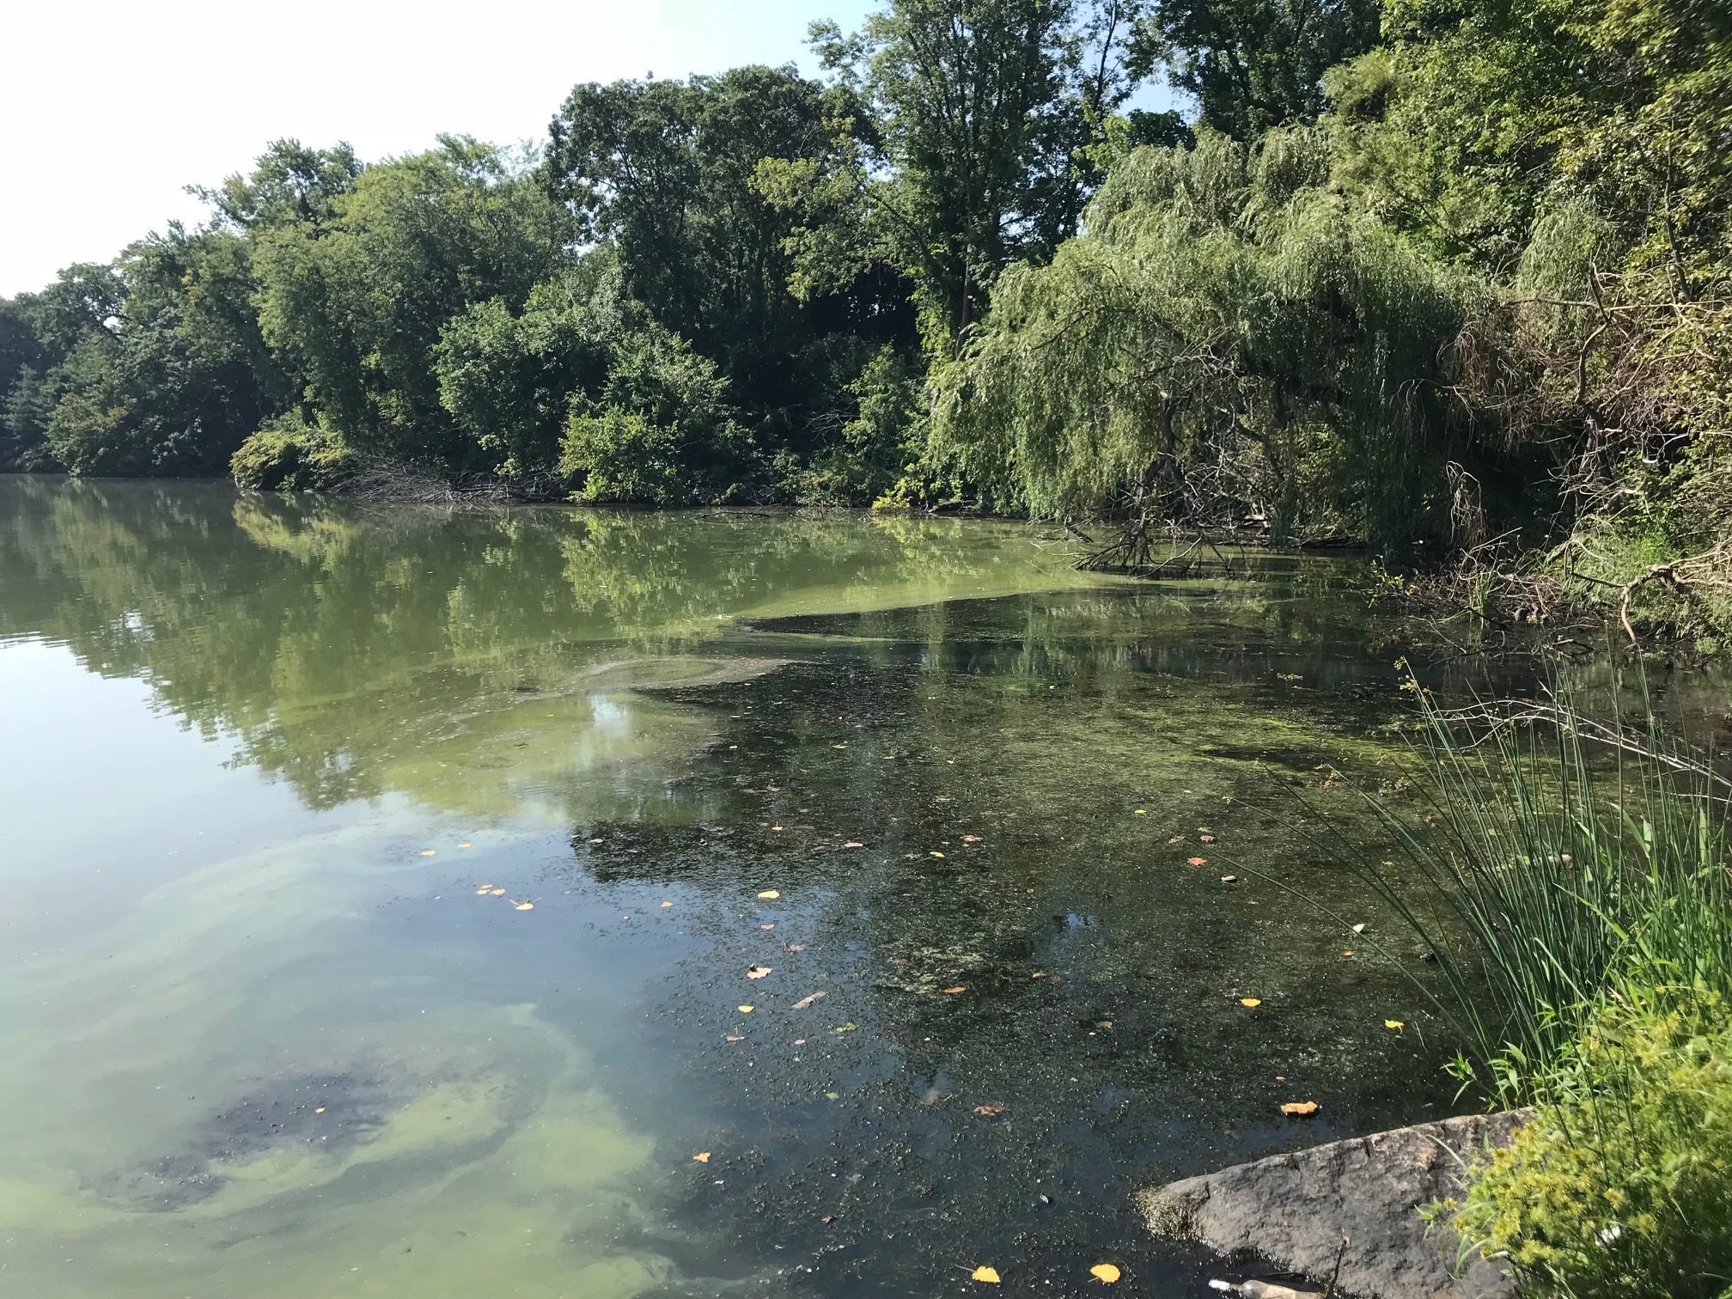
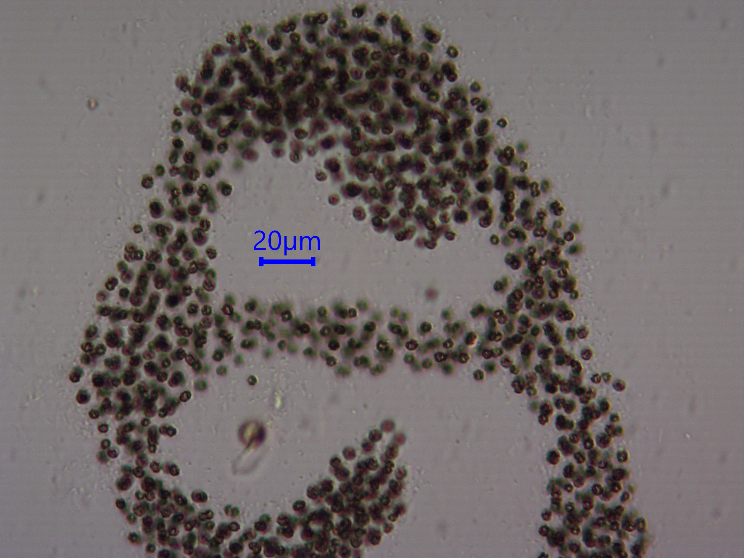
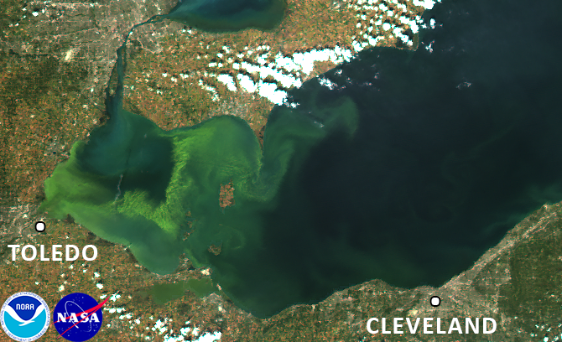
Computational ecology: Why Cyanobacteria?
What are they?
Primordial ooze
Everywhere
Photosynthetic bacteria
Why do we study them?
Agency Priority
Excess nutrients can cause blooms
Toxins
Hypoxia
Lots we don’t know
Image Credit: NASA

Slide 8
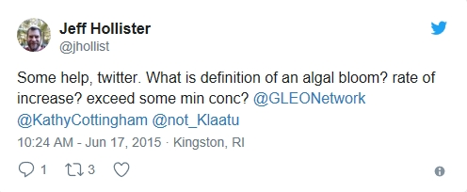
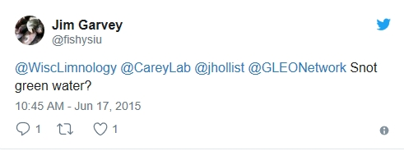
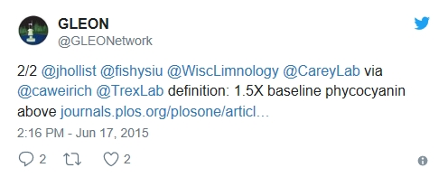
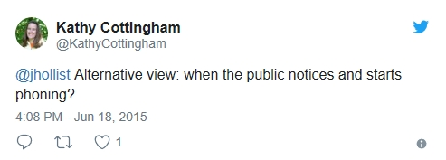
Computational ecology examples: Associations between microcystin and chlorophyll
Hollister and Kreakie. (2016). Associations between Chlorophyll a and various Microcystin-LR Health Advisory Concentrations. F1000Research
Uses NLA 2007
Empirical method to answer, “What is a bloom?”
Published at F1000Research immediately after clearance

Slide 9
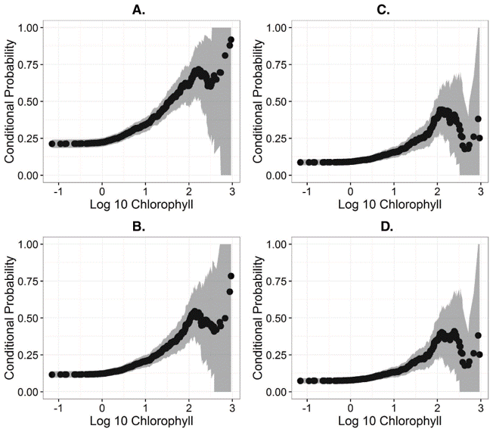
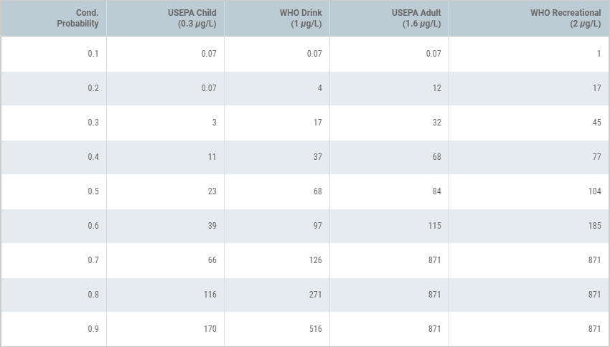
Computational ecology examples: Associations between microcystin and chlorophyll
Hollister and Kreakie. (2016). Associations between Chlorophyll a and various Microcystin-LR Health Advisory Concentrations. F1000Research
Uses NLA 2007
Empirical method to answer, “What is a bloom?”
Published at F1000Research immediately after clearance

Slide 10
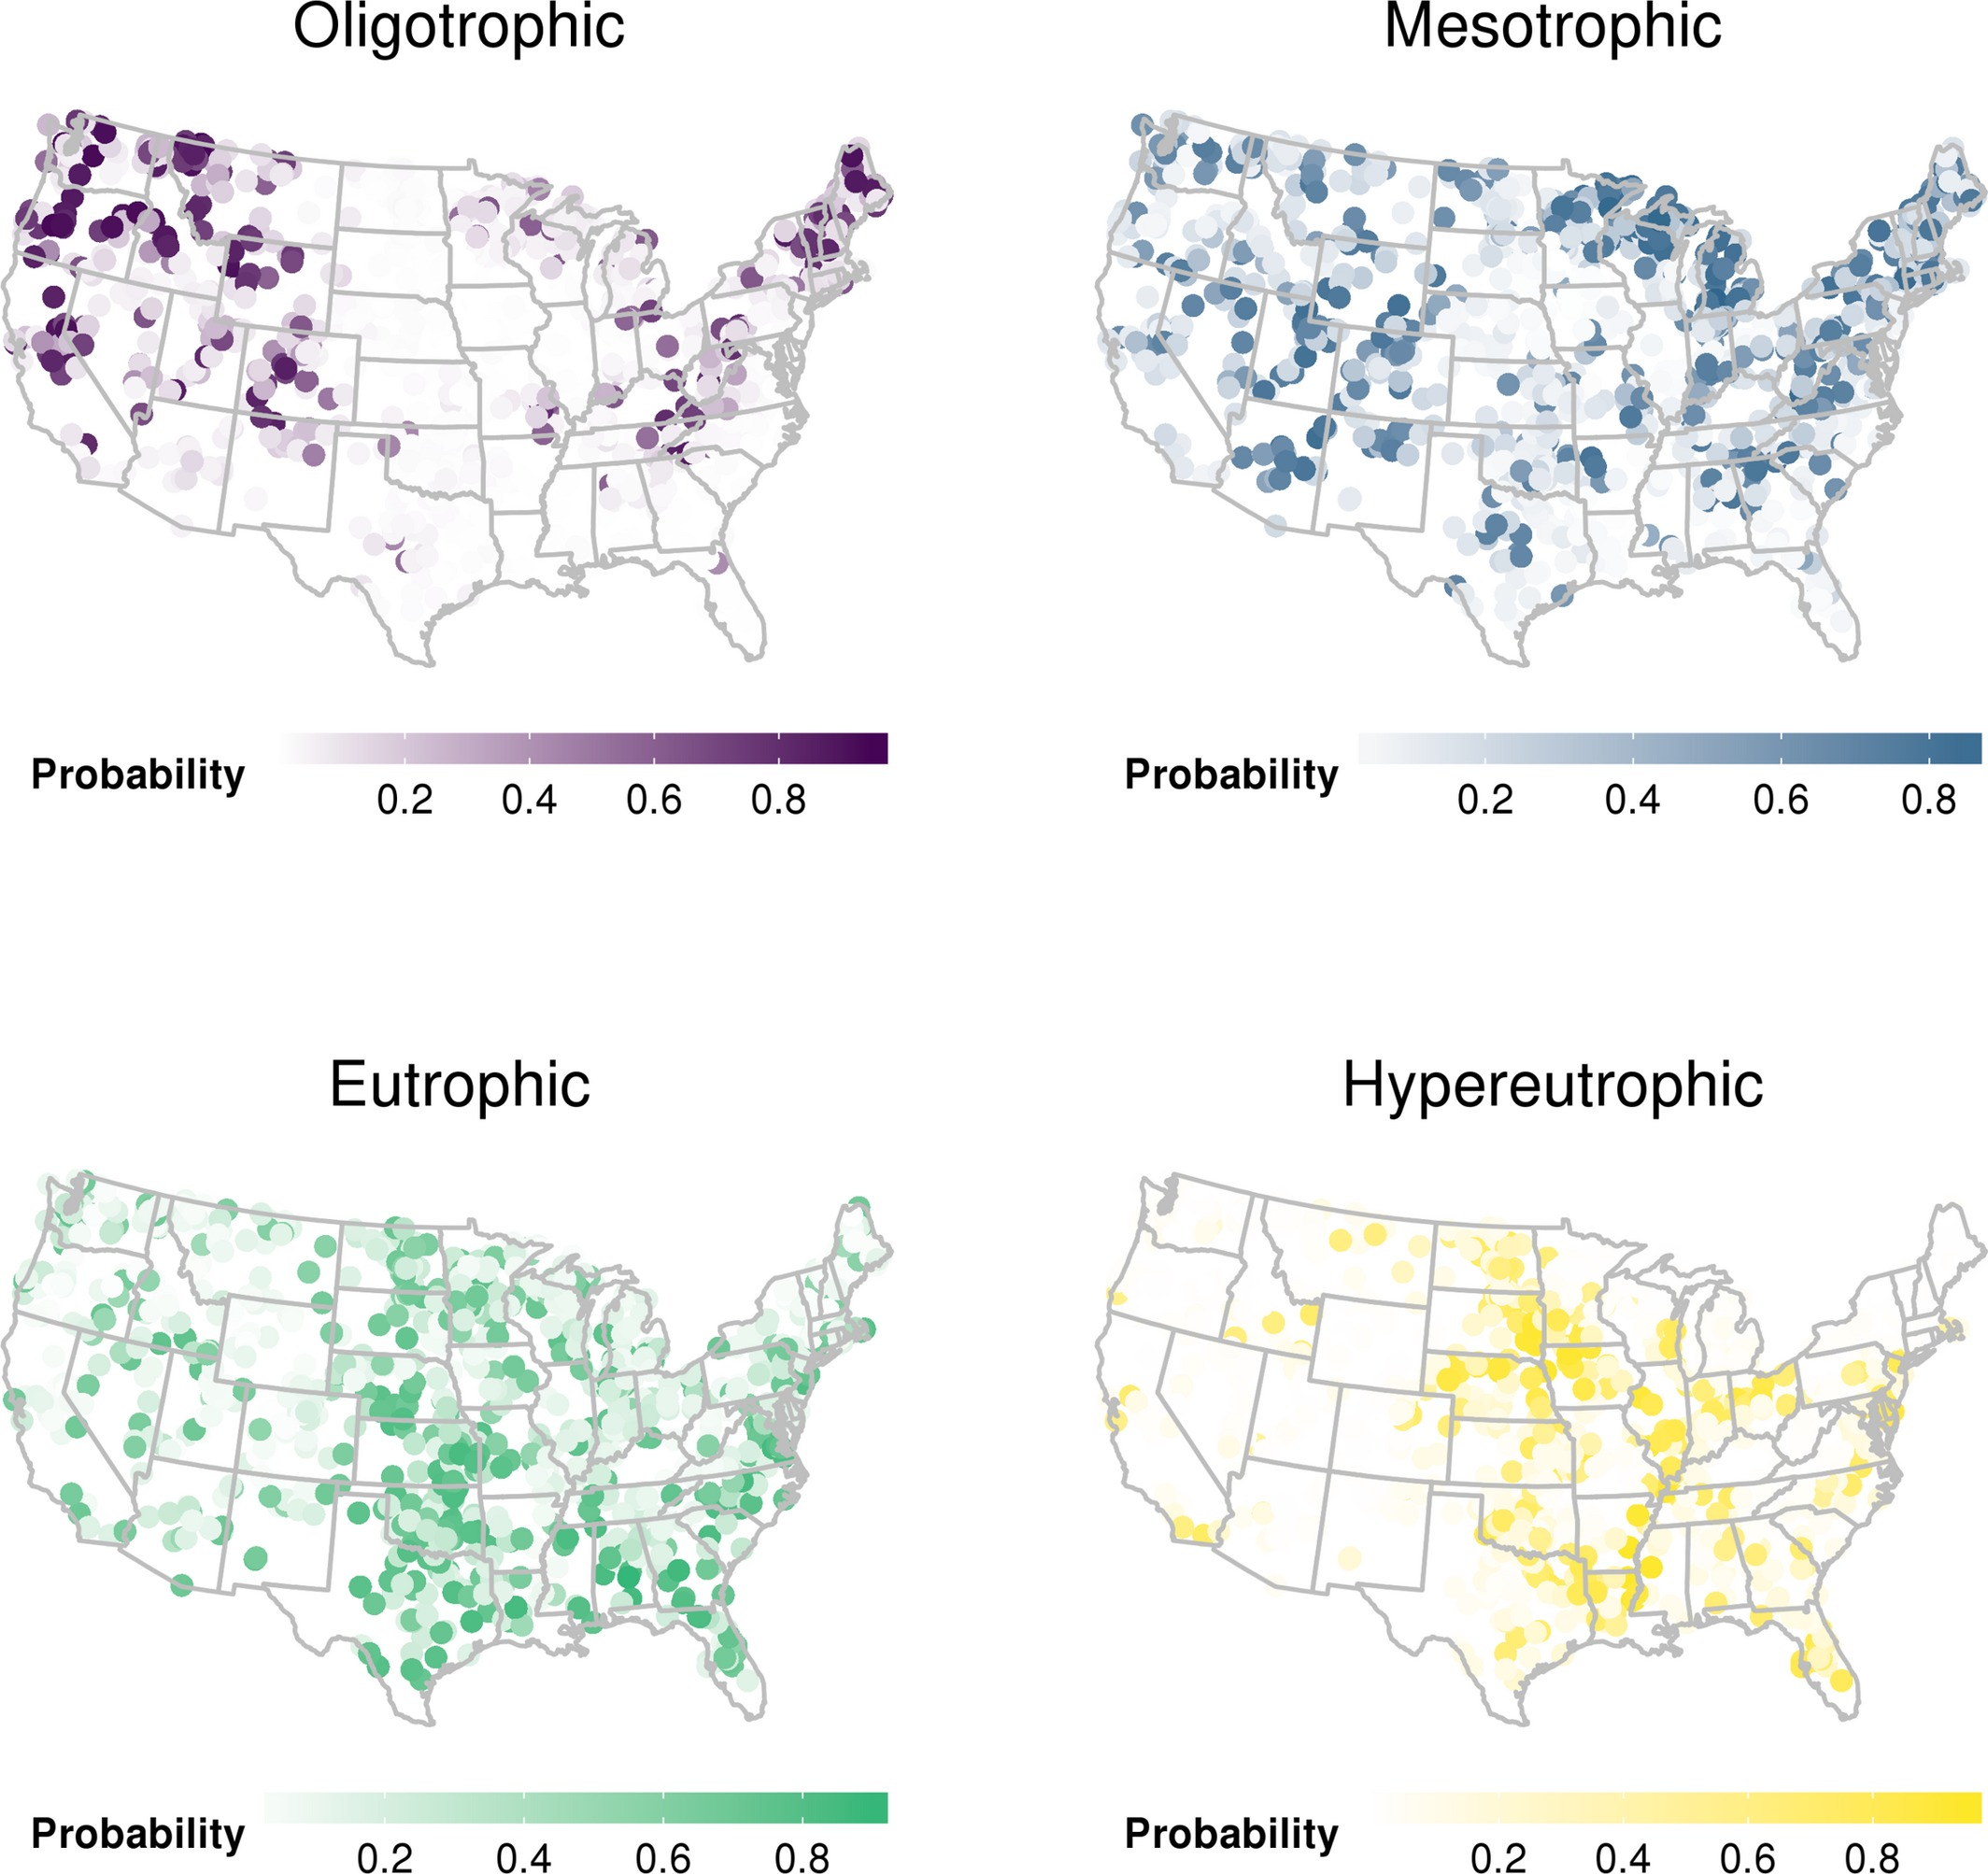
Computational ecology examples: Lake trophic state and random forests
Hollister et al. (2016). Modelling lake trophic state: a random forest approach. Ecosphere
Uses NLA 2007
Random forests to predict chlorophyll a based trophic state
After clearance, before peer-review published as a PeerJ Preprint

Slide 11
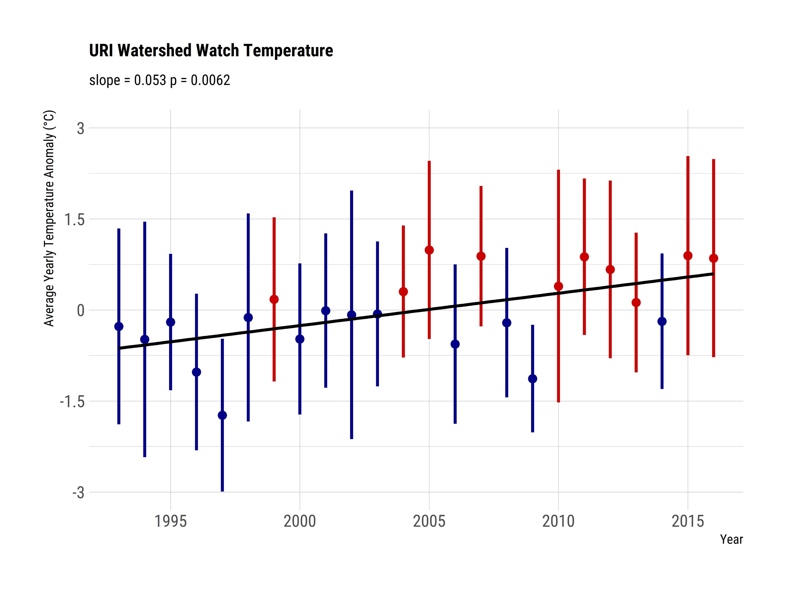
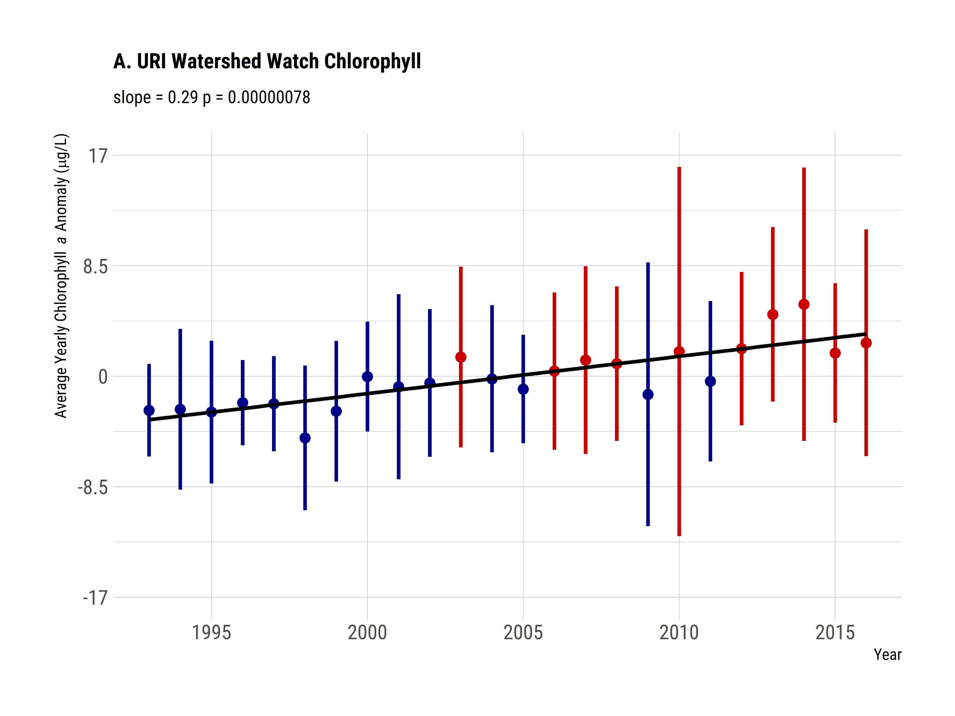
Computational ecology examples: Rhode Island water quality trends
Hollister et al. (In Review) Increasing Chlorophyll a Amid Stable Nutrient Concentrations in Rhode Island Lakes and Reservoirs. Ecosphere
What are the long term water quality trends in RI lakes and reservoirs
URI Watershed Watch and LAGOSNE
Why computational?
Big(ish) data
~ 30 years
Multiple times per year
100s of lakes
50+ MB
~365000 rows
Develop/modified analytical methods
Open science

Slide 12
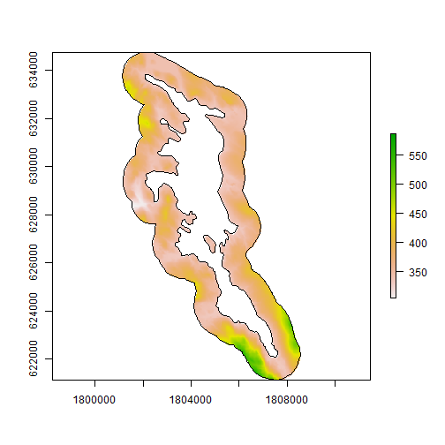
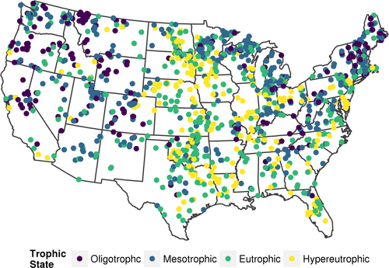
What are the limits to using existing data?
Limited to scale of questions that can be answered
Temporal
Spatial
Analytes/Data type
Location
Sometimes need to collect new data!

Slide 13

Stop, Shivers time…

Slide 14
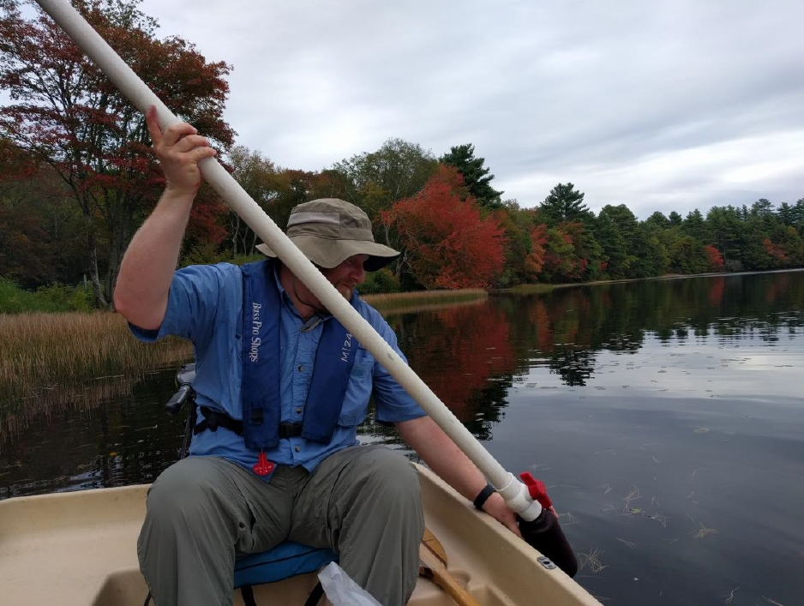
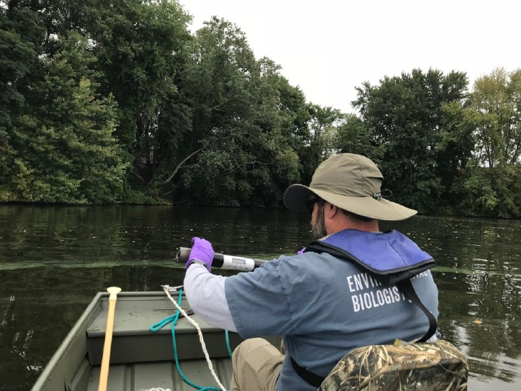
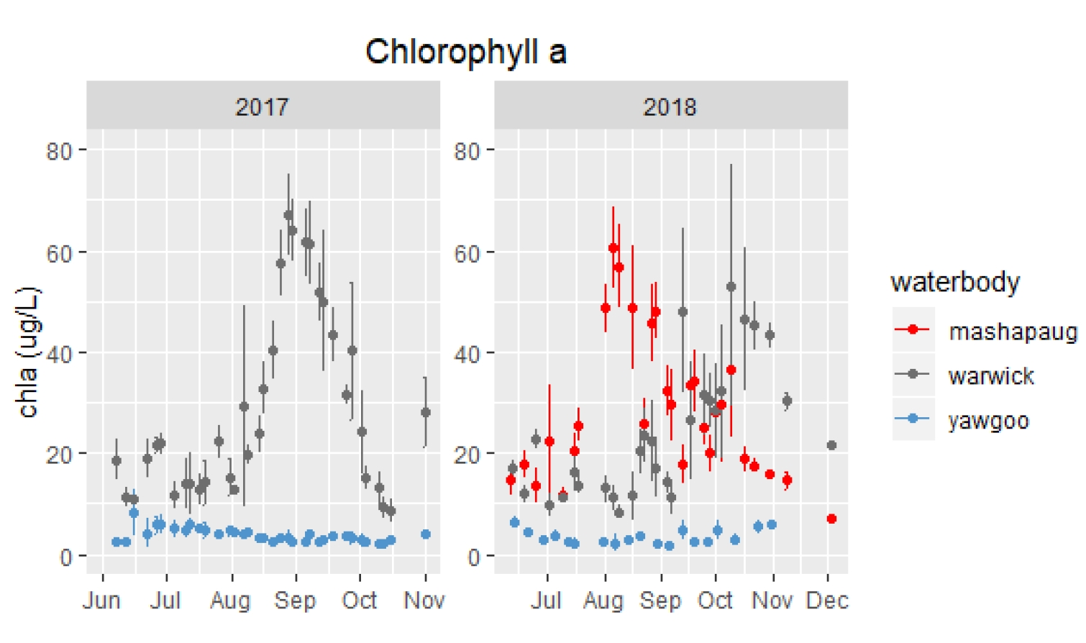
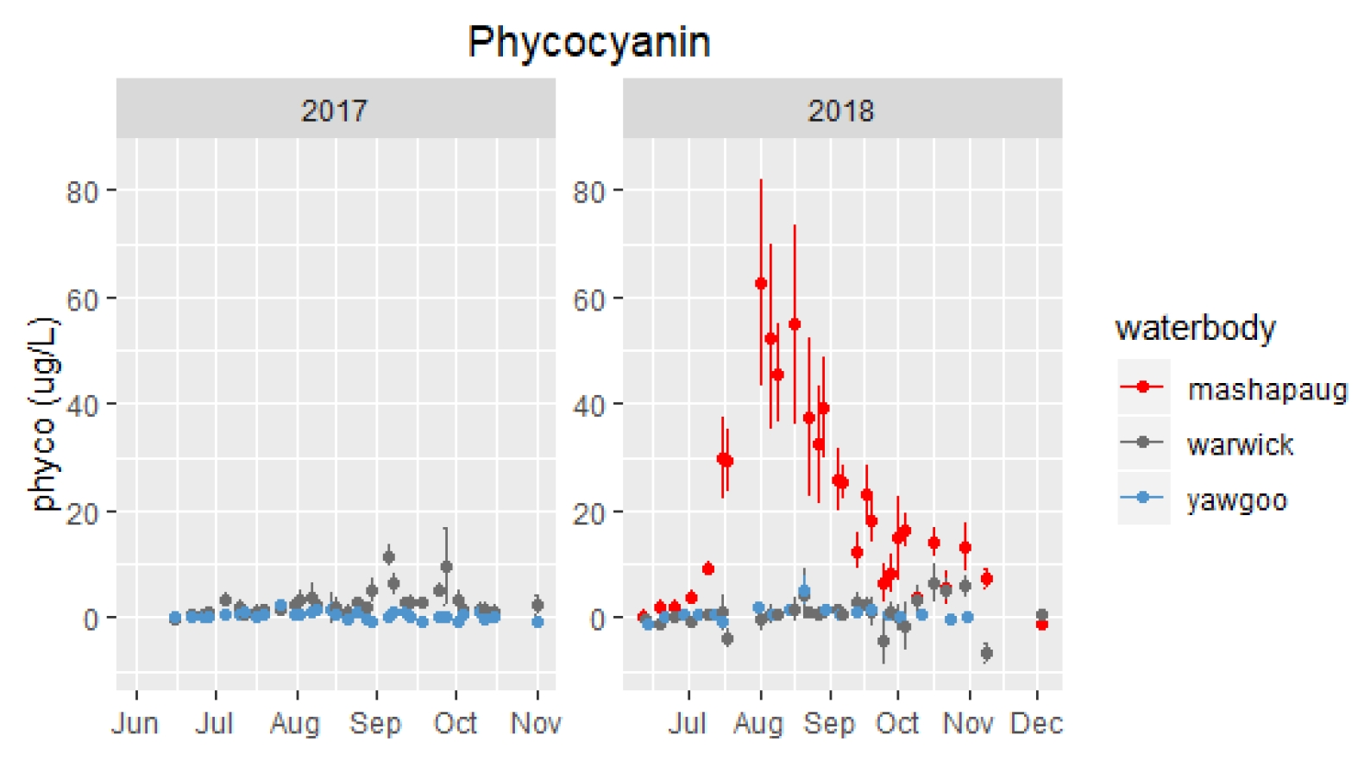
Why is our Rhode Island work computational?
Open Science
Big(ish) data
60000+ records (and counting)
Several MB
Lots of opportunities for novel methods/machine learning/etc.

Slide 15
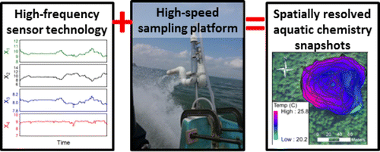
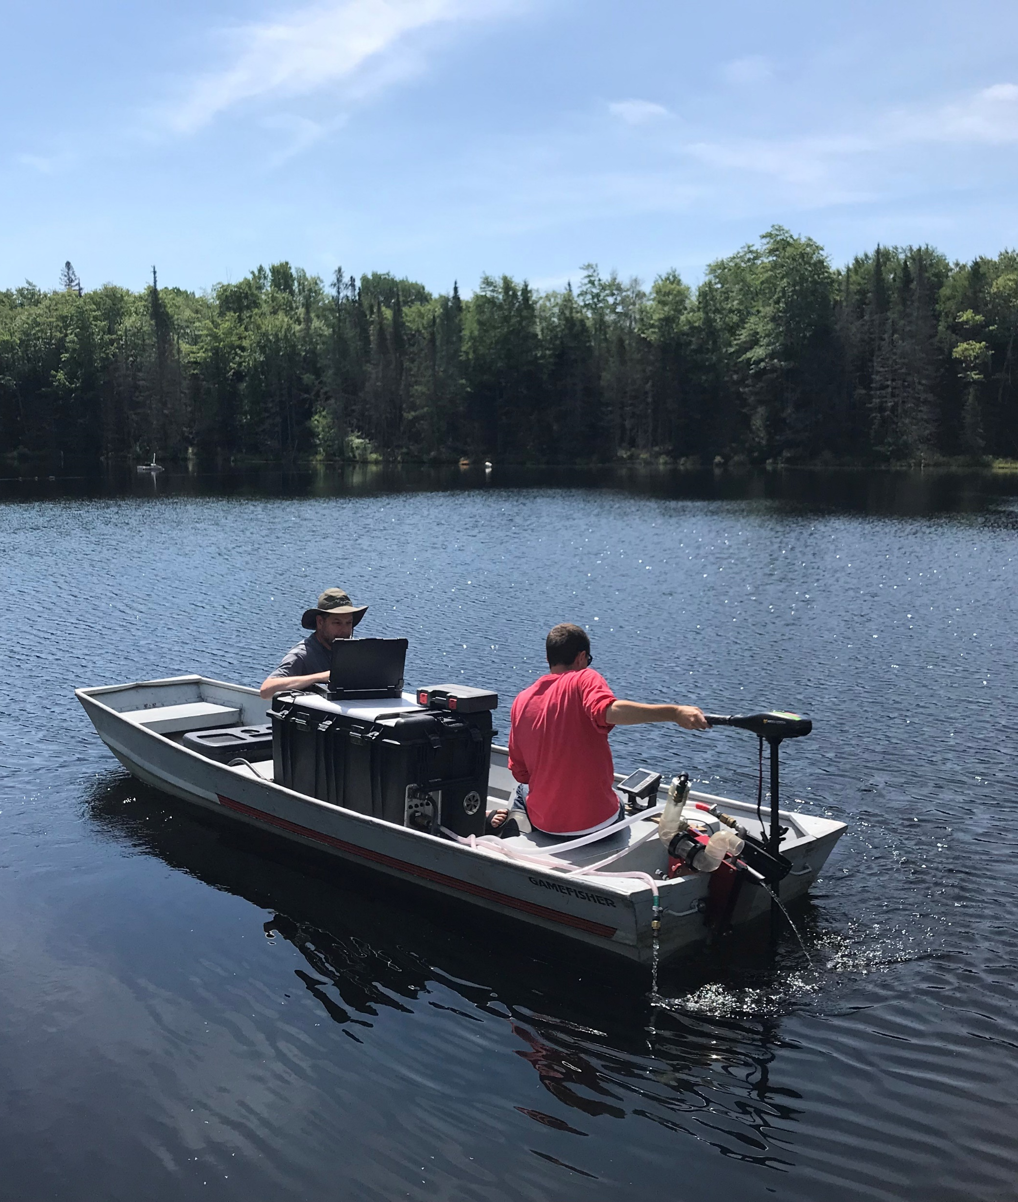
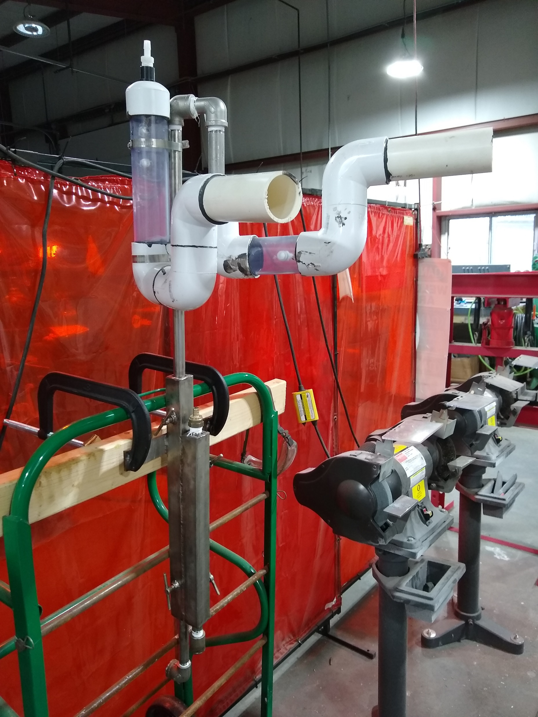
What’s next: High Resolution Data
Fast Limnological Analysis and Measurement (FLAMe)
Research Grade Buoys
CyanoHAB Evaluation And Prediction (CHEAP) buoys
Source: Crawford et al. 2015. High-Speed Limnology: Using Advanced Sensors to Investigate Spatial Variability in Biogeochemistry and Hydrology. https://pubs.acs.org/doi/full/10.1021/es504773x

Slide 16
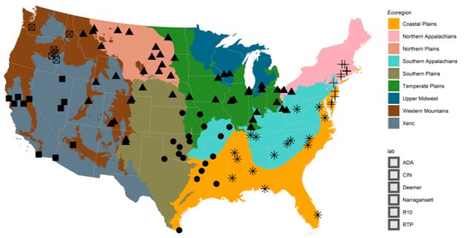
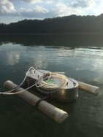
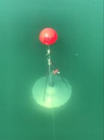
What’s next: Other field efforts
Cape Cod and Shubael’s Pond
Survey of Reservoir Greenhouse Gas Emissions (SURGE)
Image source: Jake Beaulieu, EPA, CEMM, WECD

Slide 17
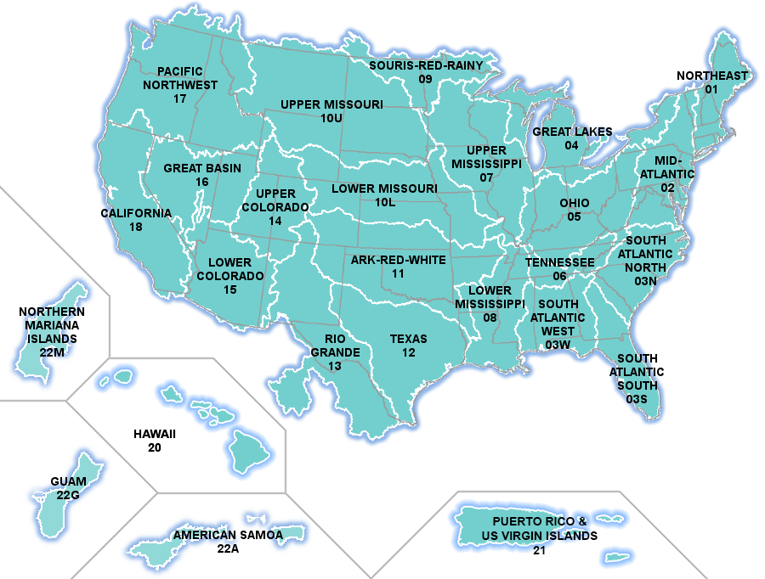
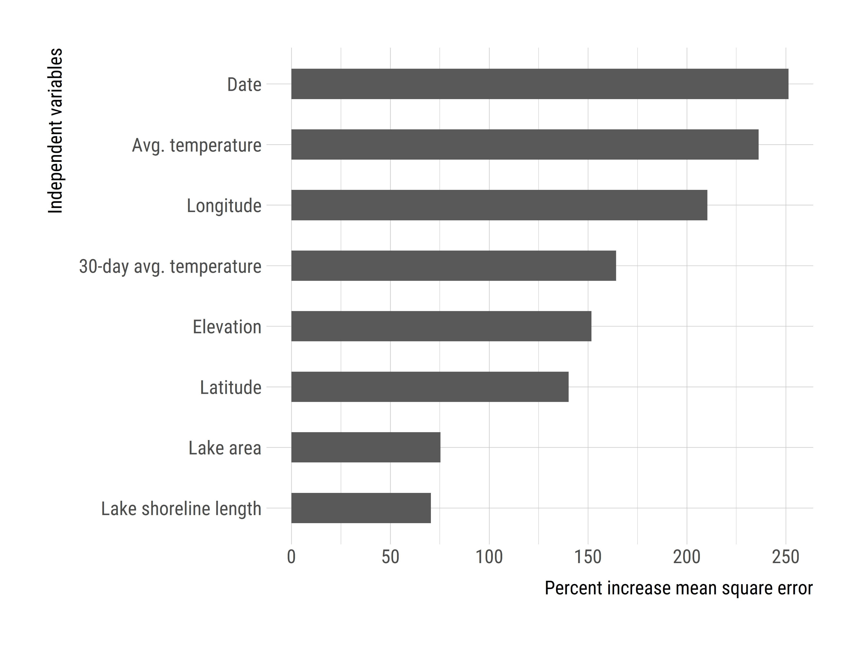
What’s next: National scale
National Lake Temperature Modelling
National Lake Morphometry Database

Slide 18
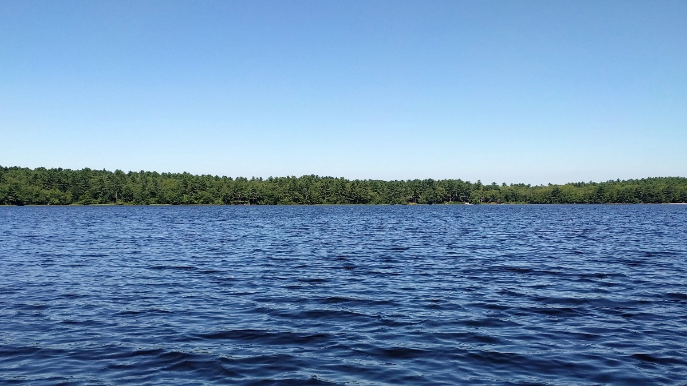
Questions?

